Slide 1
Query Processing in DDB

Slide 2
What is Query ?
A query is a statement requesting the retrieval of information.
A database query can be either a select query or an action query.
A select query is a data retrieval query, while an action query asks for additional operations on the data, such as insertion, updating or deletion.

Slide 3
What is Query Processor?
The query processor in a DBMS receives as input, parses it, generates an execution plan, and completes the processing by executing the plan and returning the results to the client.
In relational database, users perform the task of data processing and data manipulation with the help of high- level non-procedural language (e.g. SQL).
Main function of a query processor is to transform a high-level- query (also called calculus query) into an equivalent lower-level query (also called algebraic query).
This high-level query hides the low-level details from the user about the physical organization of the data and presents such an environment so that the user can handle the tasks of even complex queries in an easy, concise and simple fashion.

Slide 4
Layers of Query Processing
Query processing has 4 layers:
Query Decomposition
Data Localization
Global Query Optimization
Distribution Query Execution

Slide 5
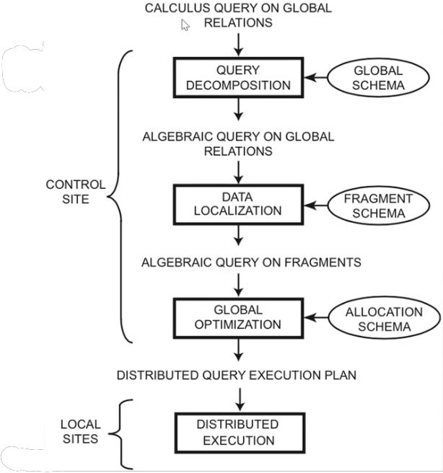

Slide 6
Query Decomposition
The first layer decomposes the calculus query into an algebraic query on global relations.
The information needed for this transformation is found in the global conceptual schema describing the global relations.
Query decomposition can be viewed as four successive steps.
Normalization
Analysis
Simplification
Restructure

Slide 7
Query Processing Example
select salary from instructor where salary < 75000;
σsalary <75000(Πsalary ( instructor ))))
Πsalary (σsalary <75000( instructor ))

Slide 8
Data Localization
The input to the second layer is an algebraic query on global relations.
The main role of the second layer is to localize the query's data using data distribution information in the fragment schema.
This layer determines which fragments are involved in the query and transforms the distributed query into a query on fragments.
A global relation can be reconstructed by applying the fragmentation rules, and then deriving a program, called a localization program, of relational algebra operators, which then act on fragments.
Generating a query on fragments is done in two steps
The query is mapped into a fragment query by substituting each relation by its reconstruction program (also called materialization program).
The fragment query is simplified and restructured to produce another "good" query.

Slide 9
Global Query Optimization
The input to the third layer is an algebraic query on fragments. The goal of query optimization is to find an execution strategy for the query which is close to optimal.
The previous layers have already optimized the query, for example, by eliminating redundant expressions.
Query optimization consists of finding the "best" ordering of operators in the query, including communication operators that minimize a cost function.
The output of the query optimization layer is a optimized algebraic query with communication operators included on fragments.
It is typically represented and saved (for future executions) as a distributed query execution plan.

Slide 10
Distribution Query Execution
Layer is performed by all the sites having fragments involved in the query.
Each sub query executing atone site, called a local query, is then optimized using the local schema of the site and executed.

